Slide 1
Functions

Slide 2
Ordered Pairs
Theatre seat no - indicating an accurate place
Example. Seat no for person 1 - (8, 15)
Seat no for person 2 - (6, 10) etc.,
Cartesian Product (A × B)
Let take two sets: Set A and set B
Set A has trains. Set B has destinations.
Then what are the possible ways of choosing trains with destination?
(A × B) = {(Train A, PUNE), (Train A, DELHI), (Train A, PATNA), (Train A, CHENNAI), (Train A, KANPUR), … (Train C, KANPUR)}
There are 15 distinct pairs are there. The above collections represents the Cartesian Product of he set of trains and destinations
Train A
Train B
Train C
PUNE
DELHI
PATNA
CHENNAI
KANPUR

Slide 3
Definition of Cartesian Product
If A and B are two non-empty sets, then the set of all ordered pairs
(a, b) - like (Train A, DELHI) – such that a ∈ A, b ∈ B is called the Cartesian Product of A and B
(A × B) of the above example is denoted as {(Train A, DELHI)| Train A ∈ A, DELHI ∈ B }
∴ (A × B) = {(Train A, DELHI)| Train A ∈ A, DELHI ∈ B }
Here, the first coordinate is element of SET A - Train A
the second coordinate is element of SET B - DELHI
Properties of Cartesian Product
(A × B) ≠ (B × A)
(A × B) = (B × A) only if A = φ OR B = φ
n (A × B) = n(B × A)
If n (A) = p, n (B) = q, then n (A × B) = pq
(a, b) ≠ (b, a), in particular, if a = b, then (a, b) = (b, a).
(A × B) - read it as A cross B; ∈ - belongs to or is a component of; | - such that or the collections of ; {} - set

Slide 4
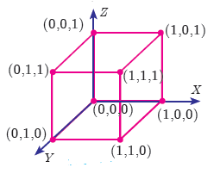
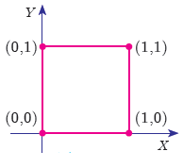
Cartesian Product of Three sets
If A, B, C are three non-empty sets, then the Cartesian product of three sets is the set of all possible ordered triplets, given by
(A × B × C) = {(a, b, c)| a ∈ A, b ∈ B, c ∈ C }
Geometrical understanding of Cartesian product of Two and Three sets
Geometrical understanding of Cartesian product of Two Sets
Geometrical understanding of Cartesian product of Two Sets
Let A = {0,1}, B = {0,1}, C = {0,1}
(A × B) × C = {(0, 0),(0,1),(1, 0),(1,1)} × {0,1}
= {(0, 0, 0),(0, 0,1),(0,1, 0),(0,1,1),(1, 0, 0),(1, 0,1)(1,1, 0),(1,1,1)}
A × B = {0,1} × {0,1} = {(0, 0),(0,1),(1, 0),(1,1)}
Representing (A × B × C) in the XYZ - space we get,
Representing A × B in the XY - plane we get,

Slide 5
Exercise
Q1. Find A × B , A × A and B × A.
A={2,−2, 3} and B={1,−4}
A×B = {(2,1),(2,−4),(−2,1),(−2,−4),(3,1),(3,−4)}
A×A = {(2,2),(2,−2),(2, 3),(−2,2),(−2,−2),(−2, 3),(3,2),(3,−2),(3, 3)}
B×A = {(1,2),(1,−2),(1, 3),(−4,2),(−4,−2),(−4, 3)}
Q2. Let A = {1,2,3} and B = {x | x is a prime number less than 10}. Find A × B and B × A.
Answer
Answer
A×B = {(1,2),(1, 3),(1,5),(1,7),(2,2),(2, 3),(2,5),(2,7),(3,2),(3, 3),(3,5),(3,7)}
B×A = {(2,1),(2,2),(2, 3),(3,1),(3,2),(3, 3),(5,1),(5,2),(5, 3),(7,1),(7,2),(7, 3)}

Slide 6
Relations
Definition
Let A and B be any two non-empty sets. ‘Relation’ R from A to B is a subset of A×B satisfying some specified conditions. If x ∈ A is related to y ∈ B through R , then we write it as xRy. xRy if and only if (x,y) ∈ R .
The domain of the relation R = {x ∈ A | xRy, for some y ∈ B}
The co-domain of the relation R is B
The range of the relation R = {y ∈ B | xRy, for some x ∈ A}
From these definitions, we note that domain of R ⊆ A, co-domain
of R = B and range of R ⊆ B .
⊆ - denotes subset

Slide 7
Illustration 1
Let A = {K,L,M,N,O} and B = {Modi, Biden, Putin}, A relation R between the above sets A and B is represented by arrow diagram. Find 1. domain of R, 2. Co-domain of R, 3, Range of R
A
B
1. The domain of the relation R = {x ∈ A | xRy, for some y ∈ B}
K
L
M
N
O
R
Domain of R = {K,L,M,N}
Modi
Biden
Putin
2. The co-domain of the relation R is B
Then, domain of R = {Modi, Biden, Putin}
3. Range of R = {Modi, Biden, Putin} = co-domain of R .

Slide 8
Illustration 2
Let A = {1,3,5,7} and B = {4,8}. Find R is a relation defined by “is less than” from A to B.
Here, R is a relation defined by “is less than” from A to B, then 1R4 ( 1 is less than 4).
Similarly, it is observed that 1R8, 3R4, 3R8, 5R8, 7R8
∴ R= {(1,4), (1,8), (3,4), (3,8), (5,8), (7,8)}
Note
In the above illustration A × B = {(1,4), (1,8), (3,4), (3,8), (5,4), (5,8), (7,4),(7,8)}
R = {(1,4), (1,8), (3,4), (3,8), (5,8), (7,8)} We see that R is a subset of A × B .

Slide 9
Illustration 3
In a particular area of a town, let us consider ten families A, B, C, D, E, F, G, H, I and J with two children. Among these, families B, F, I have two girls; D, G, J have one boy and one girl; the remaining have two boys. Let us define a relation R by xRy, where x denote the number of boys and y denote the family with x number of boys. Represent this situation as a relation through ordered pairs and arrow diagram.
Ordered pairs
Arrow diagram
Number of Boys
Family
R = {(0,B),(0,F),(0,I ),(1,D),(1,G),(1,J ),(2,A),(2,C),(2,E),(2,H)}
A
B
C
D
E
F
G
H
I
J
0
1
2

Slide 10
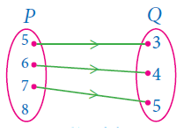
Illustration 4
The arrow diagram shows a relationship between the sets P and Q.
Write the relation in (i) Set builder form
(ii) Roster form
(iii) What is the domain and range of R.
(i) Set builder form of R = {(x,y) | y = x −2, x ∈ P, y ∈ Q}
(ii) Roster form R = {(5, 3),(6, 4),(7,5)}
(iii) Domain of R = {5,6,7} and range of R = {3, 4,5}
Note
1. If n(A) = p , n(B) =q , then the total number of relations that exist from A to B is 2^{pq} .
2. A relation which contains no element is called a “Null relation”.

Slide 11
Exercise
Q1. Let A={1,2,3,4,...,45} and R be the relation defined as “square is of a number” on A. Write R as a subset of
A x A. Also, find the domain and range of R.
Q2. Relation R is given by the set {(x,y) | y = x + 3, x ∈ {0,1,2, 3, 4,5}}. Determine its domain and range.
Q3. Represent each of the given relations by (a) an arrow diagram, (b) a graph and (c) a set in roster form, wherever possible.
(i) {(x,y)|x = 2y, x ∈ {2,3,4,5}, y ∈ {1,2,3,4}}
(ii) {(x,y)|y = x + 3, x, y are natural numbers < 10}

Slide 12
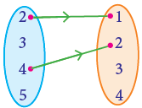
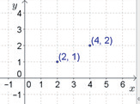
Answers
Q1. Domain of R - {1,2, 3, 4,5,6}
Range of R - {1, 4,9,16,25, 36}
Q2. Domain of R - {0,1,2,3,4,5},
Range of R - {3, 4,5,6,7, 8}
Q3. (i) X Y (ii) (ii) {(2,1),(4,2)}

Slide 13
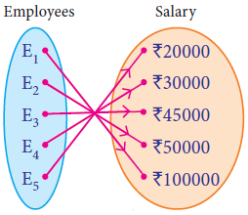
Functions
Among several relations that exist between two non-empty sets, some special relations are important for further exploration. Such relations are called “Functions”.
A company has 5 employees in different categories. If we consider their salary distribution for a month as shown by arrow diagram in figure. We see that there is only one salary associated for every employee of the company.
Definition
A relation f between two non-empty sets X and Y is called a function from X to Y if, for each x ∈ X there exists only one y ∈ Y such that (x,y) ∈ f .
That is, f ={(x,y)| for all x ∈ X, y ∈Y }.
A function f from X to Y is written as f : X → Y .
function f can be thought as a mechanism (or device) which gives a unique output f(x) to every input x.

Slide 14
Functions
POINTS TO REMEMBER
If f : X → Y is a function then,
The set X is called the domain of the function f and the set Y is called its co-domain
. If f (a) = b, then b is called ‘image’ of a under f and a is called a ‘pre-image’ of b.
all images of the elements of X under f is called the ‘range’ of f.
Every element in the domain of f has an image is said that f : X → Y is a function.
If f : X → Y is a function only if the image is unique
If A and B are finite sets such that n(A) = p , n(B) = q, then the total number of functions that exist from A to B is q^{p}

Slide 15
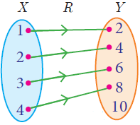
Illustration 5
Let X = {1,2, 3, 4} and Y = {2, 4,6, 8,10} and R = {(1,2),(2,4),(3,6),(4,8)}. Show that R is a function and find its domain, co-domain and range?
Arrow diagram of given relation
domain = {1,2, 3, 4}
co-domain = {2, 4,6, 8, 10}
range = {2, 4,6, 8}
{x ∈ A | xRy, for some y ∈ B}
co-domain of the relation R is B
{y ∈ B | xRy, for some x ∈ A}
All elements in X have only one image in Y. Therefore R is a function.

Slide 16
Illustration 6
If X = {–5,1,3,4} and Y = {a,b,c}, then which of the following relations are functions from X to Y ?
R1 = {(–5,a), (1,a), (3,b)}
R2 = {(–5,b), (1,b), (3,a),(4,c)}
(iii) R3 = {(–5,a), (1,a), (3,b),(4,c),(1,b)}

Illustration 7
Let f (x) = 2x+5. If x ≠ 0 then find (f (x +2) − f(2))/x.
2
4
6
8

Solution;
= (f (x +2) − f(2))/x = ((2 (x +2) + 5 - (2 x 2 + 5) )/x
= (2x + 4 +5 – 4 - 5 )/ x
= 2

Slide 17
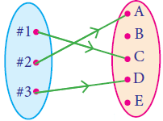
Functions
Representation of Functions
(a) a set of ordered pairs (b) a table form
(c) an arrow diagram (d) a graphical form
Types of Functions
One – one function - injection.
A function f : A → B is called one – one function if distinct elements of A have distinct images in B.
Illustration 8
If A = {1,2,3,4} and B = {a,b,c,d,e}, among the following which one is injection function?
f = {(1,a), (2,b), (3,d), (4,c)}
g = {(1,b), (2,b), (3,c), (4,e)}


Slide 18
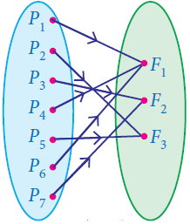
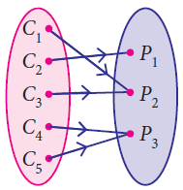
Functions
To check the fn. h(b) = 2 47b + 54 10 is one – one, we assume that h(b₁ ) = h(b₂ ) .
Many – one function
A function f : A→ B is called many-one function if two or more elements of A have same image in B.
Onto function
A function f : A→ B is said to be onto function if the range of f is equal to the co-domain of f.
Into function
A function f : A→ B is called an into function if there exists at least one element in B which is not the image of any element of A.

Slide 19
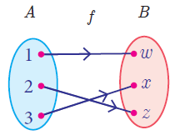
Functions
Bijection
If a function f : A→ B is both one–one and onto, then f is called a bijection from A to B.
This process is widely used in the study of secret codes called cryptography
Test for Functions
Vertical line test | Horizontal Line Test
A curve drawn in a graph represents a function, if every vertical line intersects the curve at only one point. | “A function represented in a graph is one–one, if every horizontal line intersects the curve at only one point”.

Slide 20
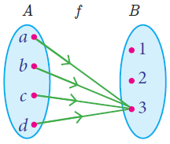
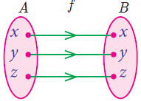
Special Cases of Functions
Constant function
A function f : A→ B is called a constant function if the range of f contains only one element. That is, f (x ) = c , for all x ∈ A and for some fixed c ∈ B
A = {a,b,c,d} , B = {1,2, 3} and f = {(a, 3),(b, 3),(c, 3),(d, 3)} . f (x) = 3 ∀ x∈ A,
Range of f ={3 }, f is a constant function.
Identity function
Let A be a non–empty set. Then the function f : A → A defined by f (x) = x for all x ∈ Ais called an identity function on A and is denoted by I_{A}.
If A = {a,b,c} then f = I_{A} = {( a, a ),(b, b ),(c, c )} is an identity function on A.

Slide 21
Special Cases of Functions
Real valued function
function f : A→ B is called a real valued function if the range of f is a subset of the set of all real numbers R. That is, f (a) ⊆ R, ∀ a ∈ A.
Illustration 9
Let f be a function from R to R defined by f (x) = 3x −5 . Find the values of a and b given that (a, 4) and (1, b) belong to f.
f (x) = 3x – 5 can be written as f = {(x, 3x – 5) | x ∈ R}
(a, 4) means the image of a is 4. i.e., f (a ) = 4
3a – 5 = 4 a = 3
(1, b) means the image of 1 is b. i.e., f (1) =b
3(1) – 5 = b ⇒ b = –2

Slide 22
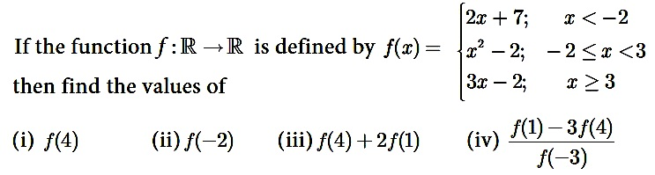
Illustration 10
(i) 10, (ii). 2, (iii). 9, (iv). 31
(i) 10, (ii). 3, (iii). 8, (iv). 31
(i) 10, (ii). 2, (iii). 9, (iv). 31
(i) 10, (ii). 2, (iii). 8, (iv). 31

Slide 23
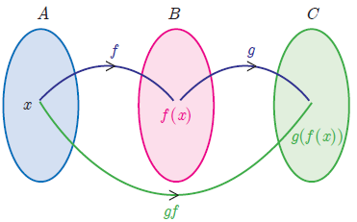
Functions
Composition of Functions
The composition of two functions is a kind of ‘chain reaction’, where the functions act upon one after another. If f and g are two functions then the composition g(f (x)) is formed in two steps.
(i) Feed an input (say x) to f ;
(ii) Feed the output f(x) to g to get g(f (x)) and call it gf(x).
Let f : A→ B and g : B → C be two functions Then the composition of f and g denoted by g o f is defined as the function g o f (x) = g(f (x)) ∀ x ∈ A.

Slide 24
Illustration 10
Find f o g and g o f when f (x) = 2x +1 and g(x) = x² −2
f o g(x) = f (g(x)) = f (x² −2) = 2(x² −2)+1 = 2x² −3
g o f (x) = g(f (x)) = g(2x +1) = (2x +1)² −2 = 4x² + 4x −1
∴ f o g ≠ g o f
Illustration 11
If f (x) = 3x −2 , g(x) = 2x +k and if f o g = g o f , then find the value of k.
f o g(x) = f (g(x)) = f (2x +k) = 3(2x +k)−2 = 6x + 3k −2
g o f (x) = g(3x −2) = 2(3x −2)+k = 6x −4 +k
Given, f o g = g o f
∴ k = −1

Slide 25
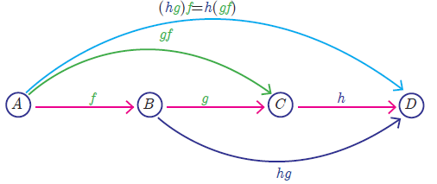
Functions
Composition of three functions
Let A, B, C, D be four sets and let f : A→ B , g : B → C and h :C → D be three functions (Fig.1.43). Using composite functions f o g and g o h, we get two new functions like (f o g) o h and f o (g o h).

Slide 26
Illustration 12
Find x if gff(x) = fgg(x), given f (x) = 3x +1 and g(x) = x + 3 .
gff(x) = g [f {f (x)}] (This means “g of f of f of x”)
= g [ f (3x +1)] = g [ 3(3x +1)+1] = g (9x + 4)
g (9x + 4) = [ (9x + 4) + 3] = 9x + 7
fgg(x) = f [g {g (x)}] (This means “f of g of g of x”)
= f [ g (x + 3)] = f [ (x + 3) + 3] = f (x + 6)
f (x + 6) = [ 3(x + 6) + 1 ] = 3x + 19
These two quantities being equal, we get 9x + 7 = 3x + 19. Solving this equation we obtain x = 2.

Slide 27
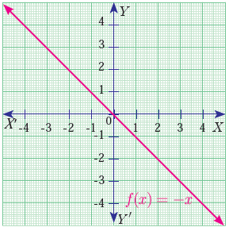
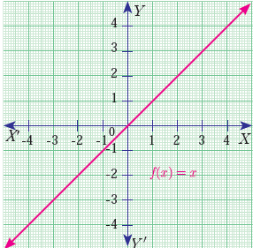
Functions
Graphs of Linear, Quadratic, Cubic and Reciprocal Functions
Linear Function
A function f : R → R defined by f (x) = mx +c , m ≠ 0 is called a linear function. Geometrically this represents a straight line in the graph.
The identity function
f : R → R defined by f (x) = x
2. Additive inverse function
f : R → R defined by f (x) = - x

Slide 28
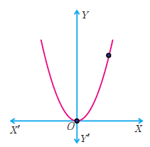
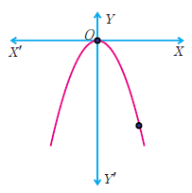
Functions
Graphs of Linear, Quadratic, Cubic and Reciprocal Functions
Quadratic Function
A function f : R → R defined by f (x) = ax² +bx + c , m ≠ 0 is called a quadratic function.
f : R → R defined by f (x) = x²
f : R → R defined by f (x) = - x²

Slide 29
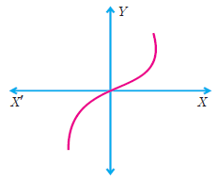
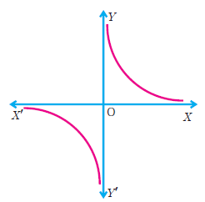
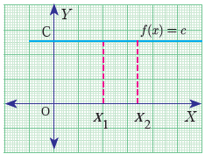
Functions
Graphs of Linear, Quadratic, Cubic and Reciprocal Functions
Cubic Function
Reciprocal Function
Constant Function
A function f : R → R defined by f (x) = ax² +bx + c , m ≠ 0 is called a quadratic function.
A function f : R ® R defined by
f (x) = c, ∀ x ∈ R
is called a constant function
f : R → {0} → R defined by f (x) = 1/x
f : R → R defined by f (x) = ax³+ bx² + cx + d
The graph of f (x) = x³ is

Slide 30
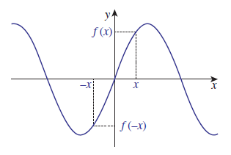
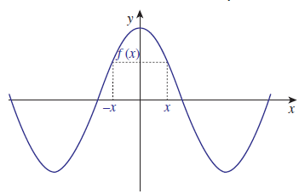
Functions
Graphs of Linear, Quadratic, Cubic and Reciprocal Functions
ODD Function
EVEN Function
A function f : R → R defined by f(-x) = - f (x) for all x ∈ R
A function f : R → R defined by f(-x) = f(x) for all x ∈ R

Slide 31
Exercise
1. f(x) = (x²+2x−15)/(x²−7x−18) is negative if and only if
-5 < x < -2 or 3 < x < 9
-2 < x < 3 or x > 9
x < -5 or 3 < x < 9
x < -5 or -2 < x < 3

2. Let f(x) = x² + ax + b and g(x) = f(x + 1) - f(x - 1). If f(x) ≥ 0 for all real x, and g(20) = 72, then the smallest possible value of b is
2
4
8
16


Slide 32
Exercise
3. How many onto functions can be defined from the set A = {1, 2, 3, 4} to {a, b, c}?
36
42
81
48

4. Give the domain and range of the following functions: A. f(x) = x² + 1; B. g(x) = log(x + 1)
A. Domain = All real numbers (x can take any value); Range [0, ∞). Minimum value of x^2 is 0.
B. Domain ( -1, ∞); Range = (-∞, +∞)4
A. Domain = All real numbers (x can take any value); Range [1, ∞). Minimum value of x^2 is 0.
B. Domain ( -0, ∞); Range = (-∞, +∞)
A. Domain = All real numbers (x can take any value); Range [-1, ∞). Minimum value of x^2 is 0.
B. Domain ( -1, ∞); Range = (-∞, +∞)
A. Domain = All real numbers (x can take any value); Range [1, ∞). Minimum value of x^2 is 0.
B. Domain ( -1, ∞); Range = (-∞, +∞)


Slide 33
Exercise
5. Find the domain of: 1/(1 − log(9 − x)) + √(x + 1)?
(-∞,9)
[-1,9)
[-1,9) excluding 0
(-1,9)

6. If f : R → {-1, 1 } → R is defined by f(x) = x/(x^2 - 1), then the value of f(2) and check whether f(x) is one-to-one function or not?
2/3 and yes, it is one - to - one function
2/3 and no, it is not one - to - one function
-2/3 and no, it is not one - to - one function
-2/3 and yes, it is one - to - one function


Slide 34
Exercise
7. Which of the following functions are identical?
1. f(x) = (x^3)/(x^2), 2. g(x) = (√(x))^2, 3. h(x) = x.
f(x) and g(x)
f(x) and h(x)
f(x), g(x) and h(x)
None of the above

8. If f(x) = 1/g(x) , then which of the following is correct?
f(f(f(g(g(g(f(g(x)))))))) = g(g(g(g(f(g(f(f(x))))))))
f(f(g(f(x)))) = g(g(f(g(x))))
f(g(f(f(g(f(g(g(x)))))))) = g(g(g(g(f(f(f(f(x))))))))
f(f(g(g(f(x))))) = g(f(g(g(g(x)))))


Slide 35
Exercise
9. The value of fogoh (9) could be, if f(x) = 1/x, g(x) = 1/(x−2), h(x) = √x
1
3
9
5

10. Let f(x) be a quadratic polynomial in x such that f(x)≥0 for all real numbers x . If f(2)=0 and f(4)=6 , then f(−2) is equal to.
11
24
19
37


Slide 36
ANSWERS
Q1. f(x) = (x²+2x−15)/(x²−7x−18) is negative if and only if
factors of = (x²+2x−15) = (x - 3) (x + 5) / (x - 9) (x + 2) < 0
roots are x= 3, -5, 9, -2
If we put x = -5, f(x) = 0, if x = -6, , f(x) = positive but the fn. Should be negative
If f(-4) = negative value. f(-3) = negative value f(-2) = negative value, f(-1) = positive value
∴ the interval must be -5 < x < -2 or 3 < x < 9
Q2. Let f(x) = x² + ax + b and g(x) = f(x + 1) - f(x - 1). If f(x) ≥ 0 for all real x, and g(20) = 72, then the smallest possible value of b is
g(x) = f(x + 1) - f(x – 1) ---------------------- apply (x + 1) in f(x)
g(x) = (x + 1)² + a (x + 1) + b - (x - 1)² + a (x - 1) + b
g(x) = 4x + 2a
g(20) = 4(20) + 2a = 72
a = -4
Let f(x) = x² + ax + b and f(x) ≥ 0
∴ x² - 4x + b ≥ 0 = (x – 2)² + b - 4 ≥ 0
We reduce the above equation to a quadratic form, b should be 4.

Slide 37
3. How many onto functions can be defined from the set A = {1, 2, 3, 4} to {a, b, c}?
Onto fn. is called, all the co-domain elements are pre-image of the domain.
1 - 3w
2 - 3w
3 - 3w
4 - 3w
A
B
c
The total number of fn, are = 3⁴ = 81 fn.s
The total non- onto fn.s are = {(1,2,3,4 → a,b, 1,2,3,4 → b,c, 1,2,3,4 → c,a) –
(1,2,3,4 → a, 1,2,3,4 → b, 1,2,3,4 → c)}
= 2⁴ + 2⁴ + 2⁴ – 3 = 45 fn.s
Then the total onto fn.s are = 81 – 45 = 36.
4. Give the domain and range of the following functions: A. f(x) = x² + 1; B. g(x) = log(x + 1)
A. f(x) = x² + 1
∴ domain is all the real numbers
Range = x = 0, f(x) = 1, x = -1, f(x) = 2
∴ range is [1, ∞)
B. f(x) = log(x + 1)
Log fn. always > 0
∴ log (x + 1) > 0
(x + 1) > 0 = x > -1
Domain = (-1, ∞)
Range = x = -1, f(x) = ∞
∴ range is (-∞, ∞)

Slide 38
5. Find the domain of: 1/(1 − log(9 − x)) + √(x + 1)?
log(9 − x)) can’t be negative
(9 − x) > 0 ⇒ x > 9
∴ 1 - log(9 − x) ≠ 0 ⇒log x = 1, x = 10
9 – x ≠ 10 ⇒x = -1.
And
√(x + 1) > 0 ⇒ x + 1 > 0 ⇒ x > - 1.
If x = -1, (1/ 1 − log(9 − x)) + √(x + 1) = undefined; If x = 9, (1/ 1 − log(9 − x)) + √(x + 1) = undefined
∴ the domain must be (-1, 9)
6. If f : R → {-1, 1 } → R is defined by f(x) = x/(x^2 - 1), then the value of f(2) and check whether f(x) is one-to-one function or not?
For checking one-to-one function, we start with the assumption f(x) = f(y).
x/(x^2 – 1) = y/(y^2 – 1) = ⇒ x/(y^2 - 1) = y(x^2 – 1)
(y - x)(xy + 1) = 0 ⇒ ∴ x = y or xy = -1.
So if we select two numbers x and y so that xy = -1, then f(x) = f(y). (2, -1/2 ); (7, -1/7 ); (-2, 1/2 ) are some among the infinitely many possible pairs.
f(2) = f(-1/2) = 2/3. That is; f(x) = f(y) does not imply x = y. Hence it is not one-to-one.

Slide 39
7. Which of the following functions are identical?
1. f(x) = (x^3)/(x^2), 2. g(x) = (√(x))^2, 3. h(x) = x.
f(x) = (x^3)/(x^2) = x can’t be 0
g(x) = (√(x))^2 = x can’t be –ve
h(x) = x can take all he possible values
∴ the above three functions are not identical
8. If f(x) = 1/g(x) , then which of the following is correct?
If f(x) = 1/g(x), then f(x) . g(x) = 1. It implies that, f(x) and g(x) are essentially inverse of one another.
Check equal no. o ‘f’s and ‘g’s on both side of equation.
Option ‘c’, → f(g(f(f(g(f(g(g(x)))))))) = g(g(g(g(f(f(f(f(x)))))))) is the answer

Slide 40
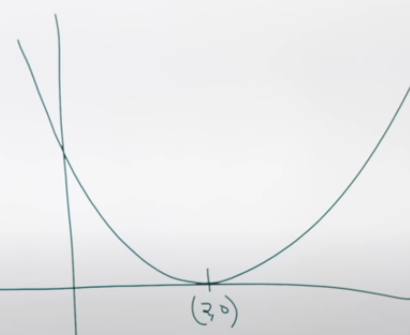
9. The value of fogoh (9) could be, if f(x) = 1/x, g(x) = 1/(x−2), h(x) = √x
fogoh (9) means f(g(h(9)))
h(9) = √x = 3
g(h(9)) = 1/(3−2) = 1
f(g(h(9))) = 1/x = 1/1 = 1
10. Let f(x) be a quadratic polynomial in x such that f(x)≥0 for all real numbers x . If f(2)=0 and f(4)=6 , then f(−2) is equal to.
Let f(x) = ax^2 + bx + c and f(x)≥0
if f(x)≥0 and f(2)=0, shows he curve has real roots and it is touching in x axis shown in the figure.
Here, the curve is U shaped and above the x-axis.
It has two roots of the equation of the curve shown in figure. The equation of the curve is (x - 2)²
If f(x) = (x - 2)², then f(4) ≠ 6, It is f(4) = (4 - 2)² = 4
∴ f(x) = k(x - 2)²
f(4) = k(4 - 2)²= 6 ⇒ k = 3/2
f(−2) = 3/2(4 - 2)²= 24

